Slide 1


Consumer Goods Ad-Hoc Analysis
Presenter: Shridatta Patil

Slide 2




AGENDA
Company Overview About Data
Objective Ad-hoc Analysis

Slide 3
About Company
AtliQ Hardware is one of the leading computer hardware producers in India as well as 26 other countries across the globe
Manufactures products under 3 major divisions i.e., Peripherals & Accessories, PC, Networking & Storage
We have a total of 74 Customers like Neptune, Sage, Leader, Vijay Sales etc. across all markets/countries

Slide 4
Objective
Assist the management team to gain more insights about the business
Take data-driven decisions to scale business

Slide 5
About Data
We have 4 fact tables i.e., sales monthly, manufacturing cost, pre invoice deductions, gross price which have measurable metrics and 2 dimension table i.e., customer details and product details.
Fiscal year for AtliQ Hardware starts from 1st September and ends on 31st August each year
Sales data is available for fiscal year 2020-2021

Slide 6
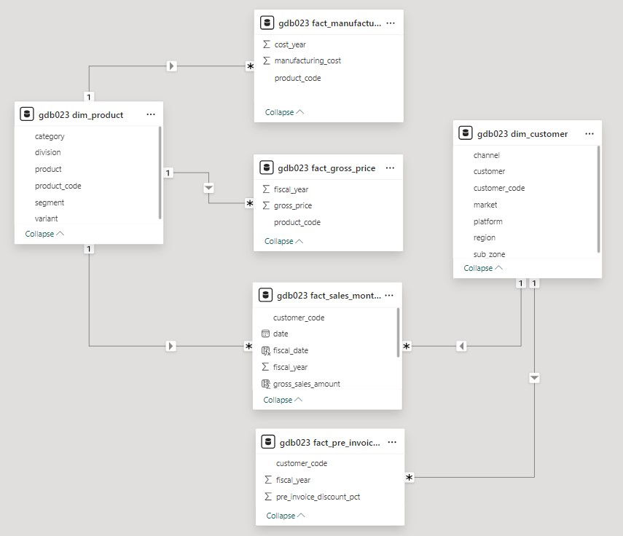
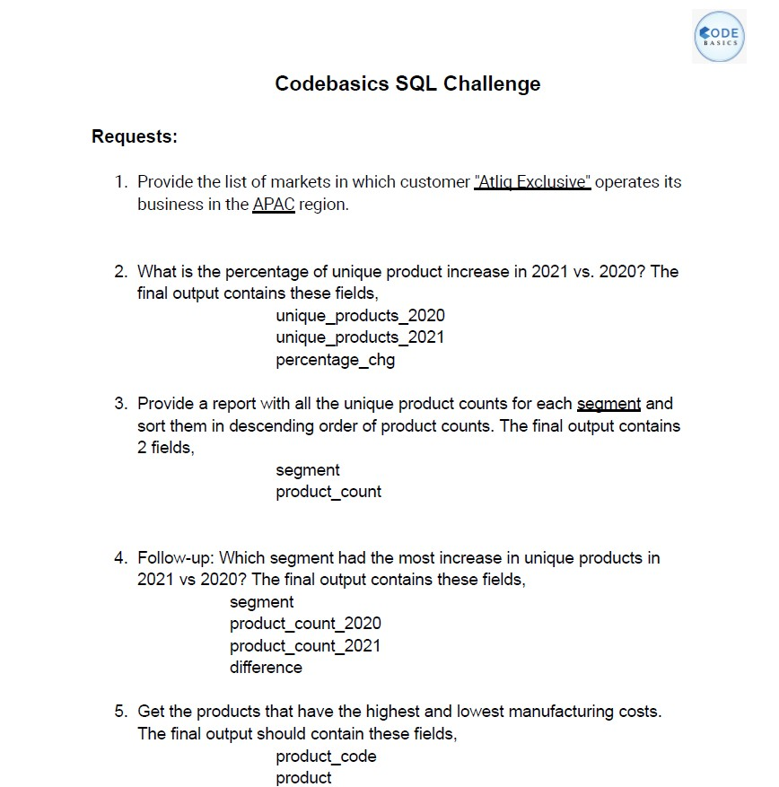
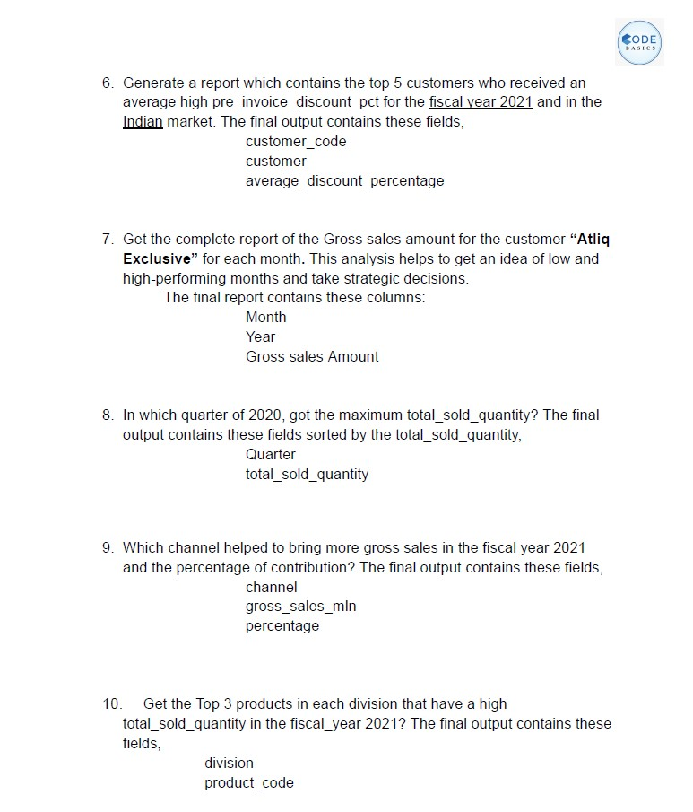

DATA MODEL
DATA AND REQUEST
TOOLS USED

Slide 7
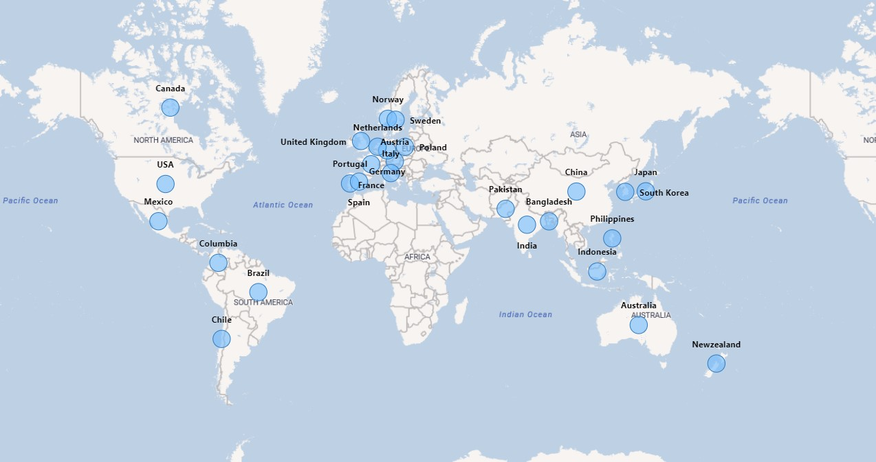
AtliQ Markets

Slide 8

Let’s Dive into ad-hoc requests query results and insights

Slide 9
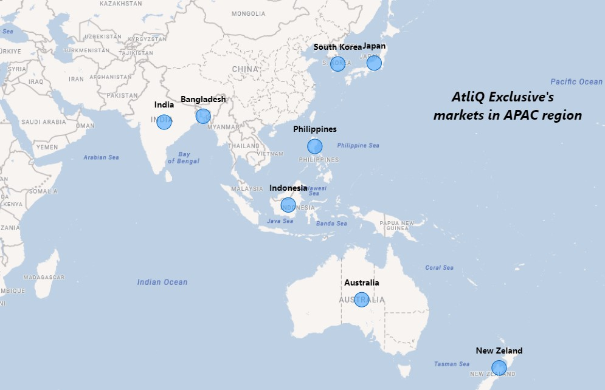
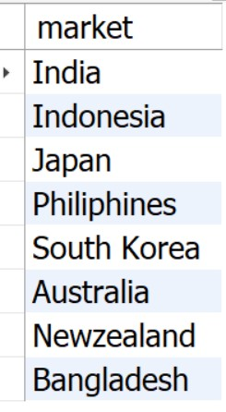
1.Provide the list of markets in which customer "Atliq Exclusive" operates its business in the APAC region.
Insights
Atliq Exclusive operates its business in 8 major markets of Asia Pacific region
Atliq Exclusive has the most stores in APAC region followed by EU(6) and NA(2)

Slide 10
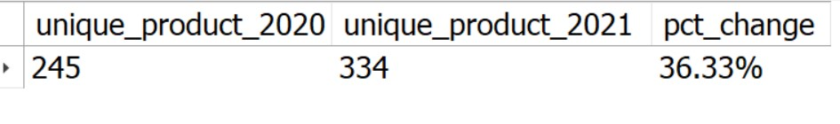
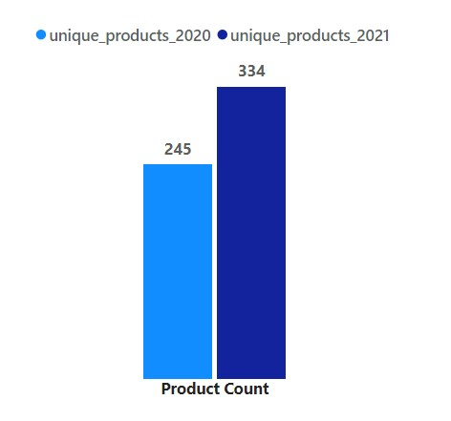
2. What is the percentage of unique product increase in 2021 vs. 2020? The final output contains these fields: unique_products_2020, unique_products_2021, percentage_chg.
36.33%
Increase
Insights
36.33% increase in new products, Altiq is building a strong and dynamic reputation by meeting with the changing needs of the customer

Slide 11
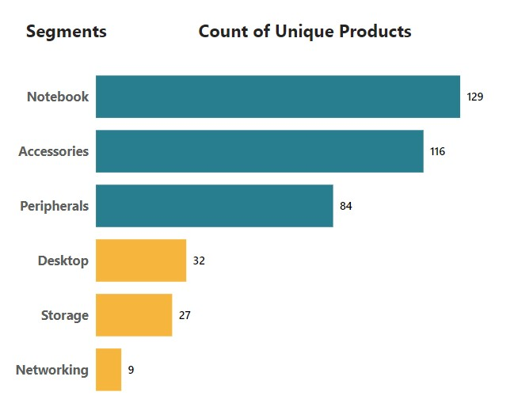
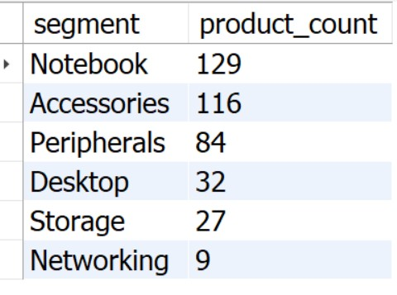
3.Provide a report with all the unique product counts for each segment and sort them in descending order of product counts.
Insights
We have a wide range of products under segment: Notebook, Accessories and Peripherals averaging around 110 while segment like Desktop, Storage and Network are lagging with an average of 23 products per segment
Notebooks, accessories, and peripherals constitute 83% of the total manufactured product

Slide 12
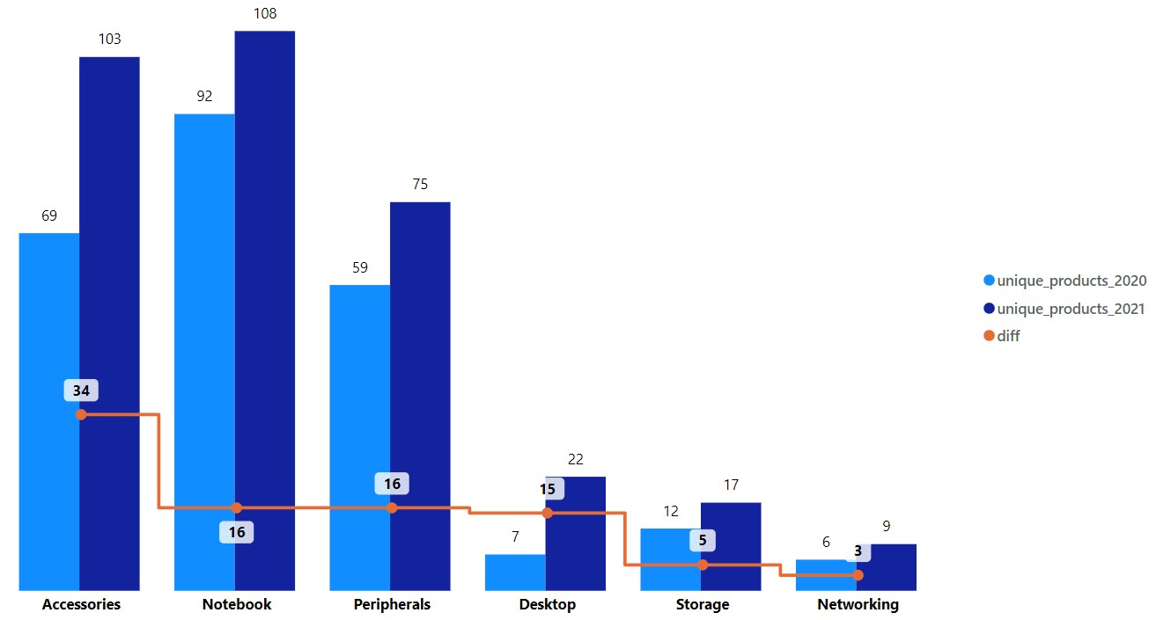
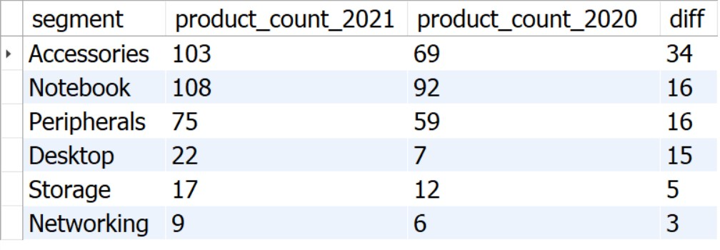
4. Follow-up: Which segment had the most increase in unique products in 2021 vs 2020?
Insights
With the introduction of 34 new products, Accessories segment has the highest increase in number of unique products
Notebook and Peripherals each has an increment of 16 new unique products
Desktop segment by increasing unique products from 7 to 22
Networking segment is at the bottom with 3 new products introduced since 2020

Slide 13
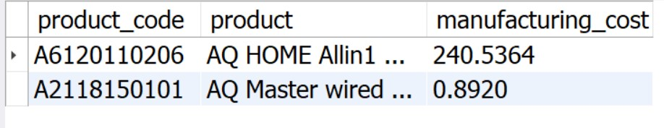


5. Get the products that have the highest and lowest manufacturing costs. The final output should contain these fields: product_code, product, manufacturing_cost
Insights
Highest manufacturing cost
Lowest manufacturing cost
AQ HOME Allin1 Gen 2 (Plus 3)
Category: Personal Desktop
AQ Master wired x1 Ms (Standard 1)
Category: Mouse
$240.54
$0.89

Slide 14
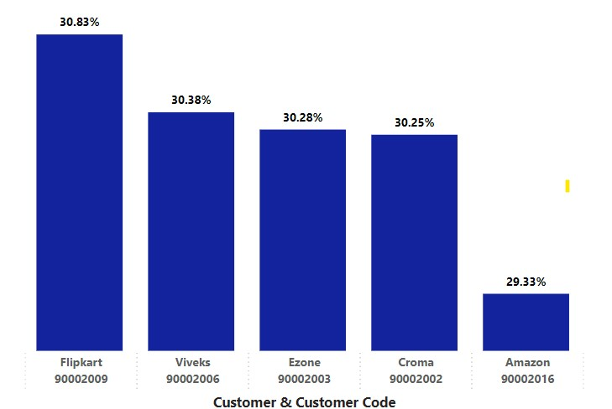
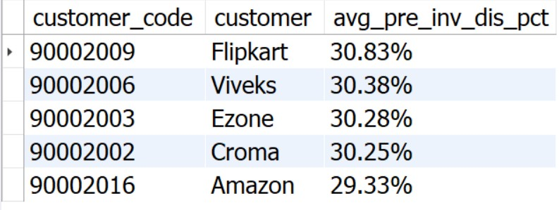
6. Generate a report which contains the top 5 customers who received an average high pre_invoice_discount_pct for the fiscal year 2021 and in the Indian market. The final output contains these fields: customer_code, customer, average_discount_percentage
Insights
Flipkart has received the highest pre invoice discount percent i.e., 30.83%
Top 5 Customers have a collective average around 30.21%
FY 2021, Average discount provided to all customers in Indian market was 24.16%

Slide 15
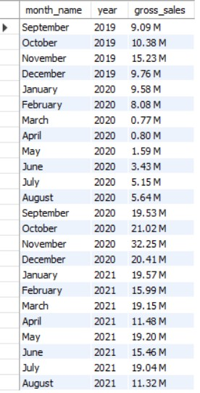
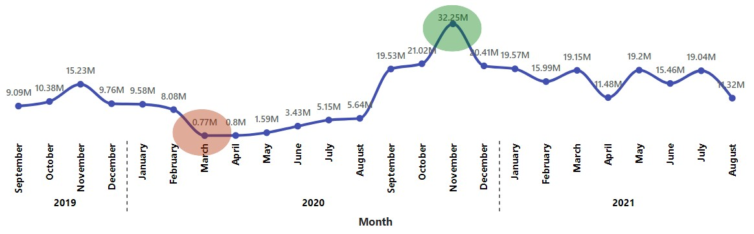
7. Get the complete report of the Gross sales amount for the customer “Atliq Exclusive” for each month. This analysis helps to get an idea of low and high-performing months and take strategic decisions. The final report contains these columns: Month, Year, Gross sales Amount
Insights
The highest gross sales for both fiscal years occurred in November 2020, while the lowest gross sales for both fiscal years were recorded in March 2020
However, it’s a very good sign that the sales increased quickly after August and reached the highest level since the last two years in November.

Slide 16
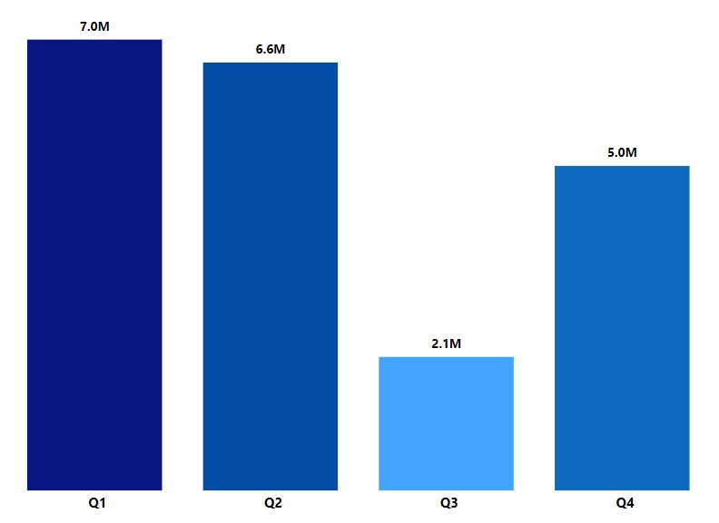
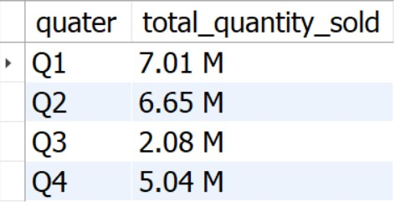
8. In which quarter of 2020, got the maximum total_quantity_sold? The final output contains these fields sorted by the total_quantity_sold: Quarter, total_quantity_sold
Insights
Q1( September-November) had the maximum quantity sold for FY 2020
Sales dropped in Q3( March-May) because of pandemic
Increase in sales recorded in Q4(June-August)

Slide 17
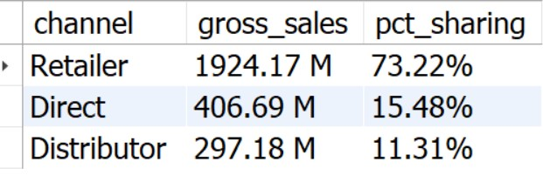
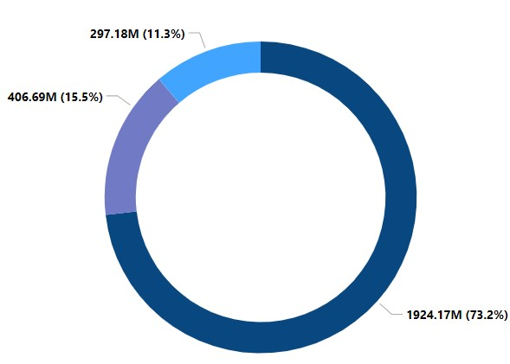
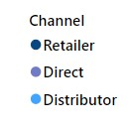
9. Which channel helped to bring more gross sales in the fiscal year 2021 and the percentage of contribution? The final output contains these fields: channel, gross_sales_mln, percentage
Insights
Retailers with $1924.17 Million which is 73.2% of gross sales for FY 2021 followed by Direct channel with $406.69 Million and Distributor with $297.18 Million

Slide 18
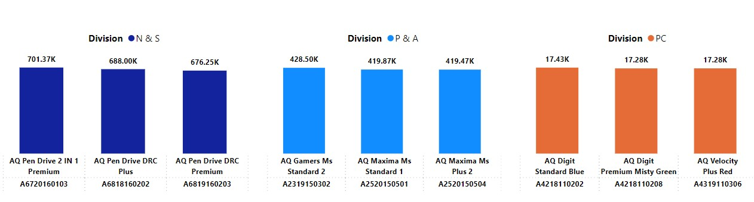
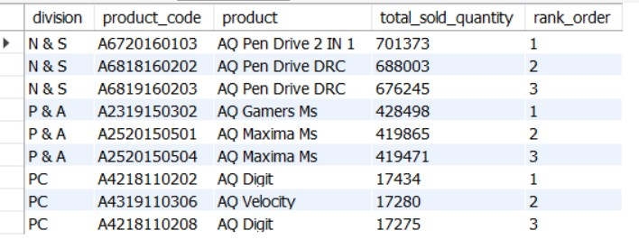
10. Get the Top 3 products in each division that have a high total_sold_quantity in the fiscal_year 2021? The final output contains these fields: division, product_code, product, total_sold_quantity, rank_order
Insights
For N&S, the top selling product is AQ Pen Drive 2 IN 1 with a total of 7,01,373 quantities sold in FY 2021 followed by two variants of AQ Pen Drive DRC with 6,88,003 and 6,76,245 quantity sold respectively
For P&A, top selling product is AQ Gamers Ms with 4,28,498 quantities sold followed by two variants of AQ Maxima Ms
For PC, top selling product is AQ Digit PC with 17,434 quantities sold
The company can take some strategic decisions to improve sale in PC division

Slide 19
THANK YOU

